Slide 1


Department of Computer Science and Engineering
SIGN I NET : A DEEP LEARNING BASED MODEL TO RECOGNIZE SIGN LANGUAGE
ANNAMALAI P (211419104013)
ASHWIN KUMAR A (211419104027)
ABISHEK BENJAMIN RAJ D (211419104003)
Dr.R.JOSPHINELEELA,PROFESSOR
Dr.N.PUGHAZENDI,PROFESSOR

Slide 2
Introduction
Communication happens through speech, gestures, body language, reading, writing or through visual aids, speech being one of the most commonly used among them.
However, for the speaking and hearing impaired minority, there is a communication gap. Visual aids, or an interpreter, are used for communicating with them.
Sign Language uses manual communication to convey meaning, it involves combining handshapes, orientations and movement of the hands, arms or body to express the speaker’s thoughts. \
Sign Language consists of fingerspelling, which spells out words character by character, and word level association which involves hand gestures that convey the word meaning.
Fingerspelling is a vital tool in sign language, as it enables the communication of names, addresses and other words that do not carry a meaning in word level association.

Slide 3
Objective of the Project
This work attempts to provide a visual solution for the sign language recognition problem in the regional Indian language, where different sets of alphabets exist for each.
A state-of-the-art methodology has been adapted to implement the solution using advanced tools like MediaPipe.
Both real-time and static gestures have been tried to be recognized by training a self-generated 2D image dataset to a Neural Network.

Slide 4
Literature Survey
AUTHOR | TITLE | SOURCE
A. K. Sahoo | Indian sign language recognition using machine learning techniques | This research focused on the static hand gestures in Indian sign language for the numeric values (0-9). A digital RGB sensor was used to capture the images of the signs to build the dataset. The dataset contained 5000 total images, with 500 images for each digit from 0 to 9. Two classifiers were used based on the supervised learning technique to train the model: Naïve Bayes and kNearest NeighborK-Nearest Neighbor technique slightly performed better than the Naïve Bayes classifier in this research as the average accuracy rates of k-NN and Naïve Bayes were 98.36% and 97.79%, respectively

Slide 5
Literature Survey
AUTHOR | TITLE | SOURCE
A. Halder and A. Tayad | Real-time vernacular sign language recognition using mediapipe and machine learning | 7421 used the MediaPipe framework to get multi-hand landmarks and used Support Vector Machine (SVM) for Real-time Detection of hand signs. The average accuracy achieved was about 99%.Work adopts the hand landmarks detection approach at the core of the complete model. Using MediaPipe’s hand tracking model, 21 hand landmarks in each image containing hand signs

Slide 6
Literature Survey
AUTHOR | TITLE | SOURCE
D. A. Kumar, A. S. C. S. Sastry, P. V. V. Kishore and E. K. Kumar | 3D sign language recognition using spatio temporal graph kernels | Journal of King Saud University-Computer and Information Sciences.

Slide 7
Literature Survey
AUTHOR | TITLE | SOURCE
Wang, Y.; Fang, Z.; Hong, H.; Peng, L. | Flood susceptibility mapping using convolutional neural network frameworks. | J. Hydrol. 2020, 582, 124482.

Slide 8
Literature Survey
AUTHOR | TITLE | SOURCE
A. Das, S. Gawde, K. Suratwala and D. Kalbande | Sign language recognition using deep learning on custom processed static gesture images | International Conference on Smart City and Emerging Technology (ICSCET)

Slide 9
Literature Survey
AUTHOR | TITLE | SOURCE
N. M. Kakoty and M. D. Sharma | Recognition of sign language alphabets and numbers based on hand kinematics using a data glove | Procedia Computer Science, vol.133,p.55–62.

Slide 10
Problem Statement
Deaf and dumb people communicate among themselves using sign language but normal people find it difficult to understand their language.
Extensive work has been done on American sign language recognition but Indian sign language differs significantly from American sign language.
ISL uses two hands for communicating whereas ASL uses single hand for communicating. Using both hands often leads to security of features duet overlapping of hands.
In addition to this, lack of datasets along with variance in sign language with locality has resulted in restrained efforts in ISL gesture detection .
Effective extension of this project to words and common expressions may not only make the deaf and dumb people communicate faster and easier with outer world, but also provide a boost . Developing autonomous systems for understanding and aiding them.

Slide 11
Proposed System
Proposed system is a sign language recognition system using convolution neural networks which recognizes various hand gestures by capturing video and converting it into frames.
This work contributes to a deep learning powered American Sign Language Recognition system focused on recognizing a few fundamental letters of the American Alphabet.
The approach includes a methodology that involves implementation of a hand tracking solution provided by Google’s open-source project, MediaPipe.
The solution produces a fast, inexpensive, lightweight, and easy-to deploy system that can be used as the core of a complete sign language recognition system.
This work adopts the hand landmarks detection approach at the core of the complete model. Using MediaPipe’s hand tracking model, 21 hand landmarks in each image containing hand signs from American Sign Language have been detected.
The landmarks are then collected as coordinate points, normalized and these data points are sent to a neural network model that takes these data-points as input, and after training the model
The prepared model for American alphabets is highly efficient, accurate, portable, and lightweight. This paper discusses the entire procedure of developing our model, along with the results and analysis of performance.

Slide 12
Software
1. Windows 10 2. Anaconda 3. Jupyter Notebook 4. Visual Studio 5. Pycharm

Slide 13
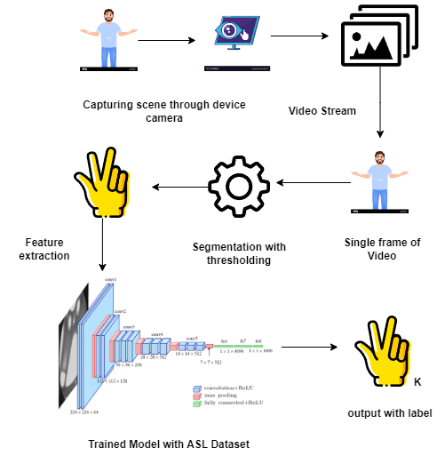
Architecture

Slide 14
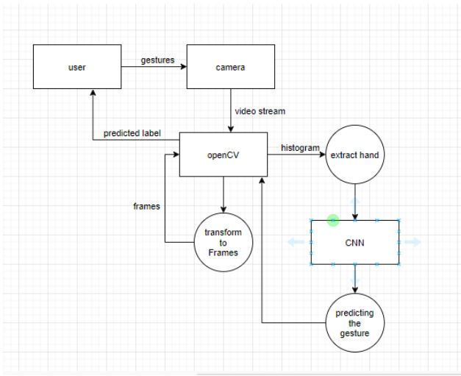
System Design - DFD

Slide 15
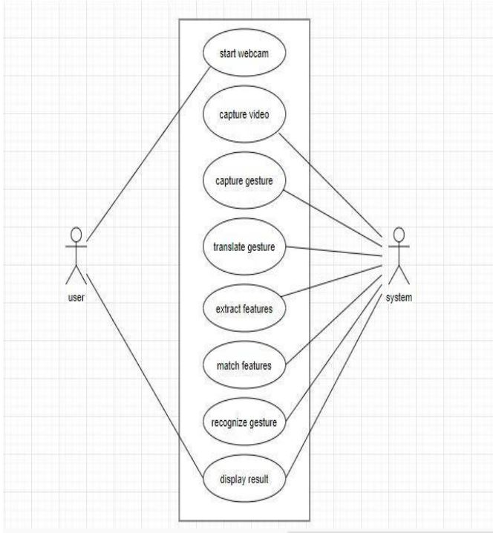
System Design –Use Case Diagram

Slide 16
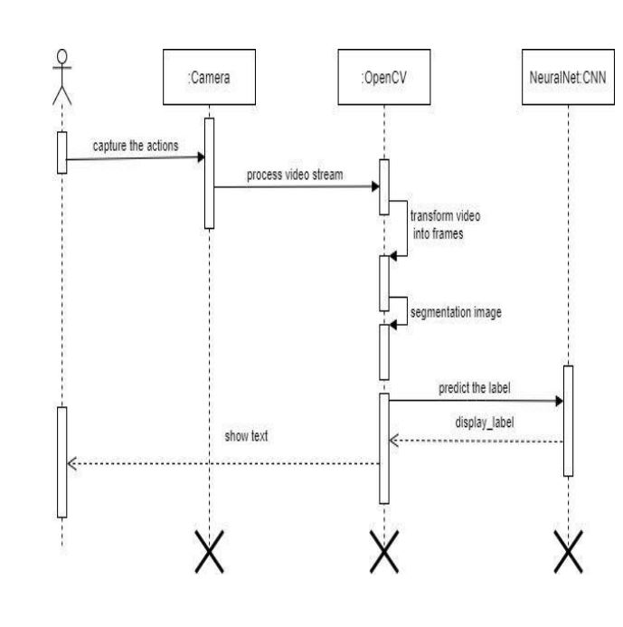
System Design – Sequence Diagram

Slide 17
Module Description
DATA PRE-PROCESSING
Data preprocessing is a process of preparing the raw data and making it suitable for a machine learning model.
It is the important process in machine learning model. When creating a machine learning project, it is not always a case that we come across the clean and formatted data so to verify that and to get a clean dataset
CLASSIFICATION
In a random forest classification, multiple decision trees are created using different random subsets of the data and features.
Each decision tree is like an expert, providing its opinion on how to classify the data. Predictions are made by calculating the prediction for each decision tree, then taking the most popular result.
The random forest would count the number of predictions from decision trees for Cat and for Dog, and choose the most popular prediction

Slide 18
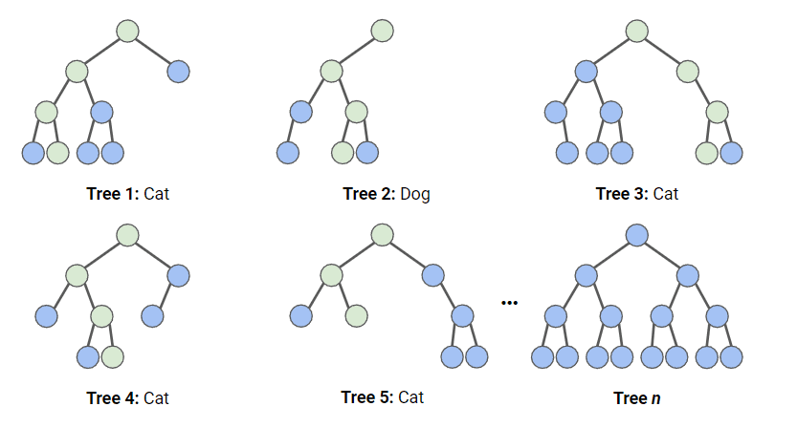
Module Description
RANDOM FOREST CLASSIFIER WORKING PRINCIPLE

Slide 19
Module Description
NORMALIZATION
Normalization is a rescaling of the data from the original range so that all values are within the new range of 0 and 1. Normalization requires that you know or are able to accurately estimate the minimum and maximum observable values. Formula : y = (x — min) / (max — min) You can normalize your dataset using the scikit-learn object MinMaxScaler.
AUTOCORRECT MODULE
Some words will sometimes have mistakes, especially when someone is learning the language for the first time. much like when we are typing using a keyboard, we will correct the word they were trying to spell to the closest estimated word.

Slide 20
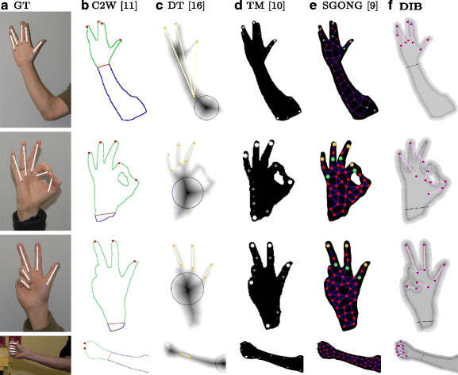
Module Description
DETECTION MODULE
The mediapipe library to find hands in the frame since it not only finds hands but also provides 22 3D coordinates of the complete hand, providing us a wealth of information to work with.
We then used this hand-detection model to extract the coordinate data from an ASL alphabet dataset.

Slide 21
Testing /Performance Evaluation / Results
BLACK BOX TESTING
Black box testing is a software testing technique that focuses on testing the functionality of a software system without knowing the internal workings of the system.
In this type of testing, the tester is not concerned with the code, architecture, or design of the system but instead focuses on the inputs and outputs of the system. The goal of black box testing is to determine whether the software system behaves correctly based on its specifications, requirements, and business logic.
WHITE BOX TESTING
White box testing is a software testing technique that focuses on testing the internal workings of a software system.
In this type of testing, the tester has access to the source code, architecture, and design of the system and uses this knowledge to create test cases that verify the correctness and quality of the system's implementation.
The goal of white box testing is to ensure that the code is written correctly, follows best practices and coding standards, and meets the design specifications.

Slide 22
Testing /Performance Evaluation / Results
TEST REPORT: 01
PRODUCT : Doing Hand Signs To Recognize The Word
USE CASE : Do Hand Signs
TEST CASE ID | TESTCASE / ACTION TO BE PERFORMED | EXPECTED RESULT | ACTUAL RESULT | PASS/FAIL
1 | Do Hand Signs | Letters Showing For The Hand Signs | Letters Showing For The Hand Signs | PASS
2 | Do Hand Signs | Extra Words Are Printed | Extra Words Are Printed | PASS

Slide 23
Testing /Performance Evaluation / Results
TEST REPORT 02
PRODUCT : Doing Hand Signs To Recognize The Word
USE CASE : Do Hand Signs
TEST CASE ID | TESTCASE/ ACTION TO BE PERFORMED | EXPECTED RESULT | ACTUAL RESULT | PASS/FAIL
1 | Do Some Hand Signs | Word Pop Ups | Word Pop Ups | PASS
2 | Do Hand Signs | Two Hands Detected Multiple Words | Two Hands Detected Multiple Words | PASS
3 | Do Hand Signs | Wrong Word Detected | Wrong Word Detected | PASS
4 | Do Hand Signs | AutoCorrected Word Diplayed | AutoCorrect ed Word Diplayed | PASS

Slide 24
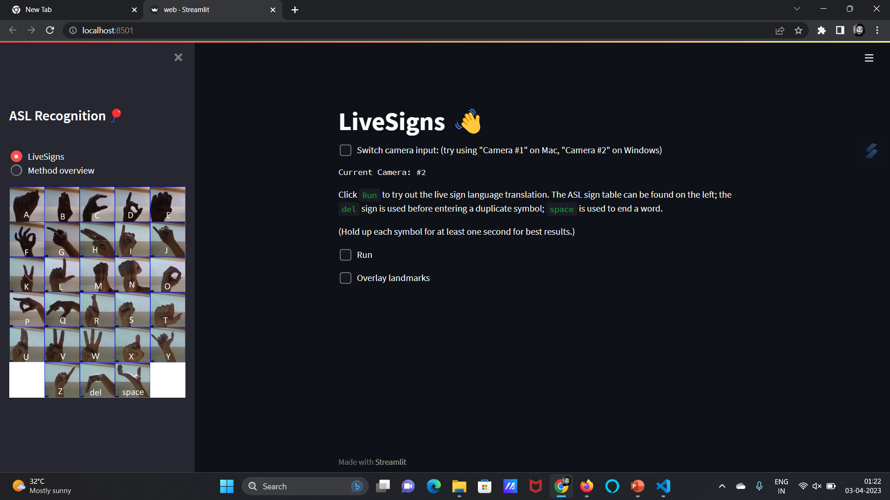
Screen Shots

Slide 25
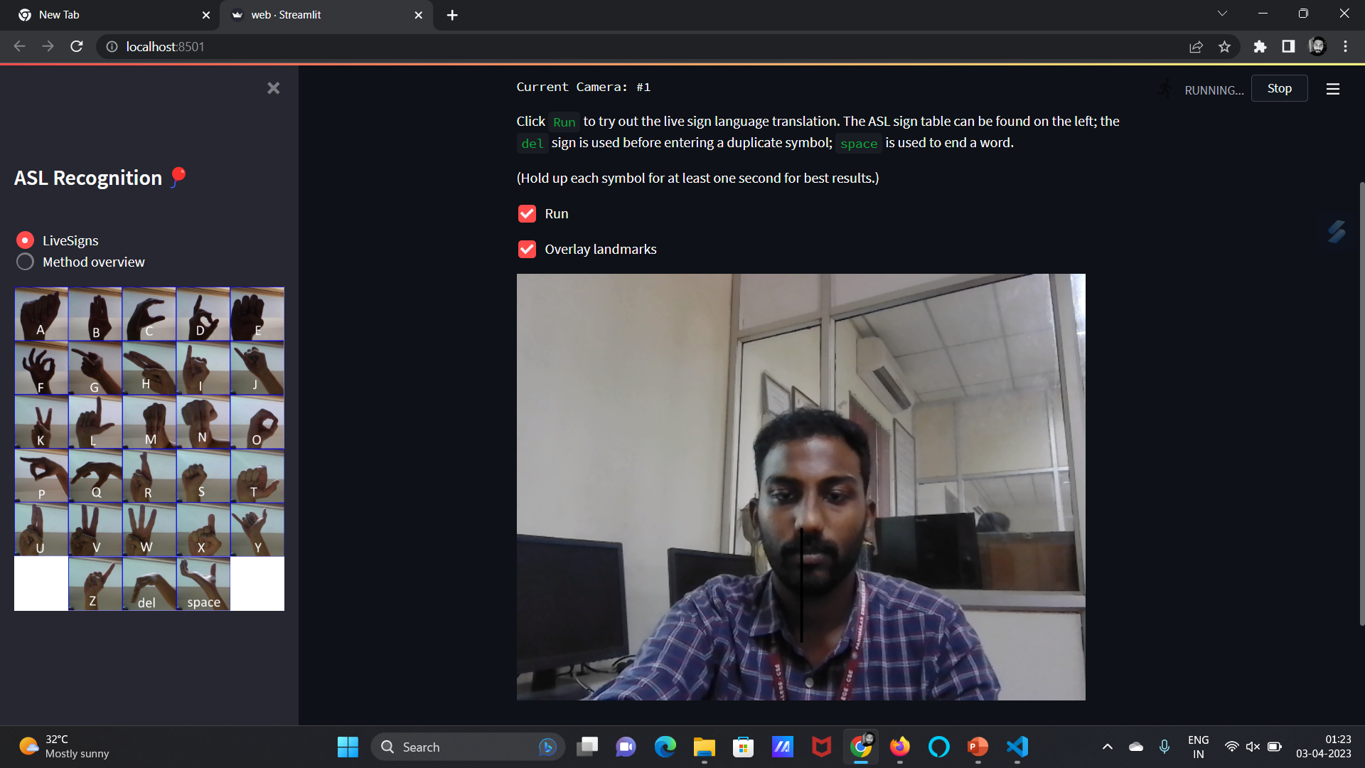
Screen Shots

Slide 26
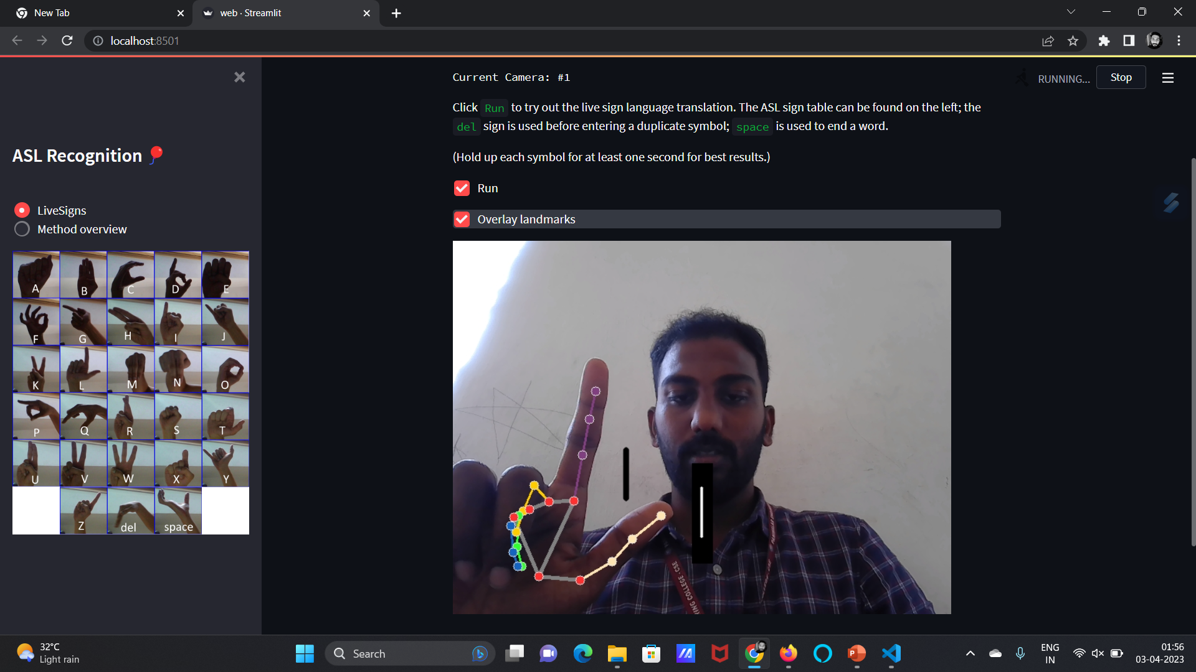
Screen Shots

Slide 27
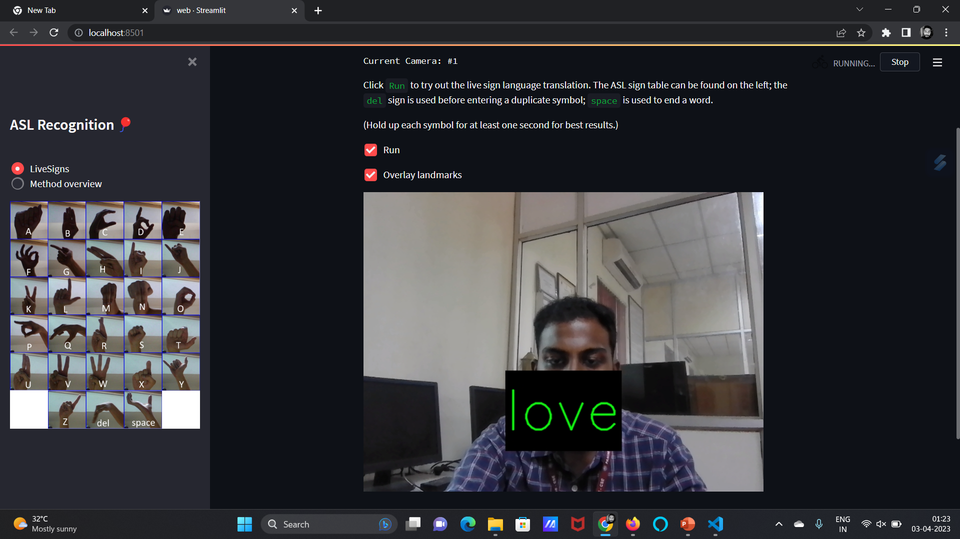
Screen Shots

Slide 28
Conclusion
Nowadays, applications need several kinds of images as sources of information for elucidation and analysis. Several features are to be extracted so as to perform various applications.
When an image is transformed from one form to another such as digitizing, scanning, and communicating, storing, etc. degradation occurs.
Therefore , the output image has to undertake a process called image enhancement, which contains of a group of methods that seek to develop the visual presence of an image.
Image enhancement is fundamentally enlightening the interpretability or awareness of information in images for human listeners and providing better input for other automatic image processing systems.
Image then undergoes feature extraction using various methods to make the image more readable by the computer.Sign language recognition system is a powerful tool to prepare an expert knowledge, edge detect and the combination of inaccurate information from different sources . The intend of convolution neural network is to get the appropriate classification

Slide 29
Future Enhancement
The proposed sign language recognition system used to recognize sign language letters can be further extended to recognize gestures facial expressions.
Instead of displaying letter labels it will be more appropriate to display sentences as more appropriate translation of language.
This also increases readability.The scope of different sign languages can be increased.
More training data can be added to detect the letter with more accuracy. This project can further be extended to convert the signs to speech.

Slide 30
Reference Paper
[1] A. K. Sahoo. (2021) "Indian sign language recognition using machine learning techniques," in Macromolecular Symposia.
[2] A. Halder and A. Tayad. (2021) "Real-time vernacular sign language recognition using mediapipe and machine learning,“ Journal homepage: www. ijrpr. com ISSN, vol. 2582, p. 7421.
[3] D. A. Kumar, A. S. C. S. Sastry, P. V. V. Kishore and E. K. Kumar. (2022) "3D sign language recognition using spatio temporal graph kernels," Journal of King Saud University-Computer and Information Sciences.
[4] Wang, Y.; Fang, Z.; Hong, H.; Peng, L. Flood susceptibility mapping using convolutional neural network frameworks. J. Hydrol. 2020, 582, 124482. [Google Scholar]
[5] A. Das, S. Gawde, K. Suratwala and D. Kalbande. (2018) "Sign language recognition using deep learning on custom processed static gesture images," in International Conference on Smart City and Emerging Technology (ICSCET).
[6] N. M. Kakoty and M. D. Sharma. (2018) "Recognition of sign language alphabets and numbers based on hand kinematics using a data glove," Procedia Computer Science, vol. 133, p. 55–62.

